Slide 1


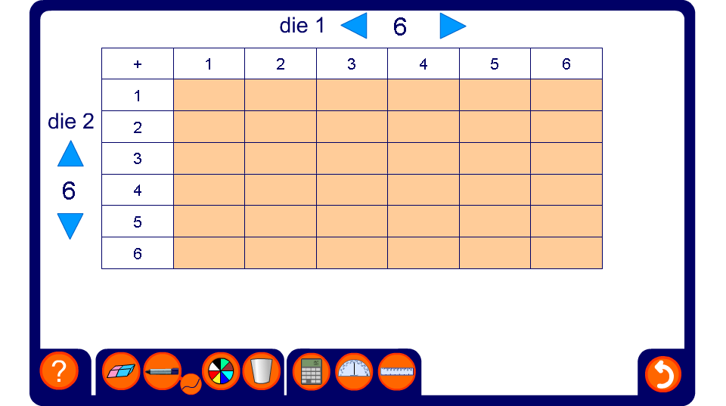


Calculating the number of outcomes
Notes:
In this activity, choose the number of sides on your two dice, and ask pupils to predict the total number of outcomes.
When the table is complete, use it to ask questions such as “What is the probability of getting a even number?”

